Slide 1
MATH221 Mathematics for Computer Science
Unit 9
Probability

Slide 2
Learning Objectives
Fundamentals knowledge of probability
Conditional Probability
Bayes’ Theorem
Independent Events

Slide 3
Introduction
Probability is the branch of mathematics concerning numerical descriptions of how likely an event is to occur, or how likely it is that a proposition is true: The probability of an event is a number between 0 and 1, where, roughly speaking, 0 indicates impossibility of the event and 1 indicates certainty.
Probability is a important pillar of the field of machine learning and data mining.

Slide 4
Introduction
To say that a process or experiment is random means that when it takes place, one outcome from some set of outcomes is sure to occur, but it is impossible to predict with certainty which outcome that will be.
Definition
A sample space is the set of all possible outcomes of a random process or experiment.
An event is a subset of a sample space.

Slide 5
Probability
Notation
For a finite set A, N(A) denotes the number of elements in A.
Probability
If S is a finite sample space in which all outcomes are equally likely and E is an event in S, then the probability of E, denoted P(E), is
P(E) =
The number of outcomes in E
N(E)
=
The total number of outcomes in S
N(S)

Slide 6


Probability: Rolling a Pair of Dice

Slide 7

Probability: Rolling a Pair of Dice
A more compact notation identifies, say, with the notation 24, with 53, and so forth.
Use the compact notation to write the sample space S of all possible outcomes.
Use set notation to write the event E that the numbers showing face up have a sum of 6 and find the probability of this event.
S = { 11, 12, 13, 14, 15, 16, 21, 22, 23, 24, 25, 26, 31, 32, 33, 34, 35, 36,
41, 42, 43, 44, 45, 46, 51, 52, 53, 54, 55, 56, 61, 62, 63, 64, 65, 66 }
E = { 15, 24, 33, 42, 51 }
P(E) = 5/36

Slide 8
Probability – Basic Properties
Basic Properties of Probability
Let S be a sample space. Let A and B be events in S. The following properties always hold:
0 ≤ P(A) ≤ 1
P(∅) = 0 and P(S) = 1
If A and B are disjoint (A ∩ B = ∅), then
P(A ∪ B) = P(A) + P(B)
Note that P(X) denotes the probability of event of X.

Slide 9
Probability – Further Properties
Probability of the Complement of an Event
If A is any event in a sample space S, then
P(A^{c}) = 1 – P(A)
Probability of a General Union of Two Events
If A and B are any events in a sample space S, then
P(A ∪ B) = P(A) + P(B) – P(A ∩ B).
Note: These two properties can be derived from the basic properties (you will not be tested on the derivation).

Slide 10


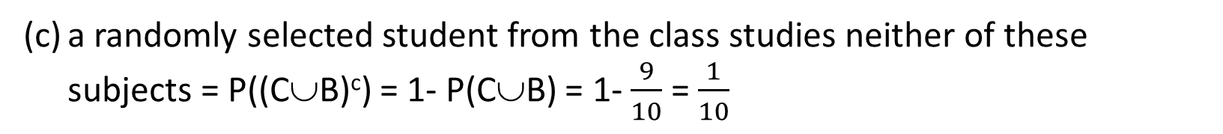
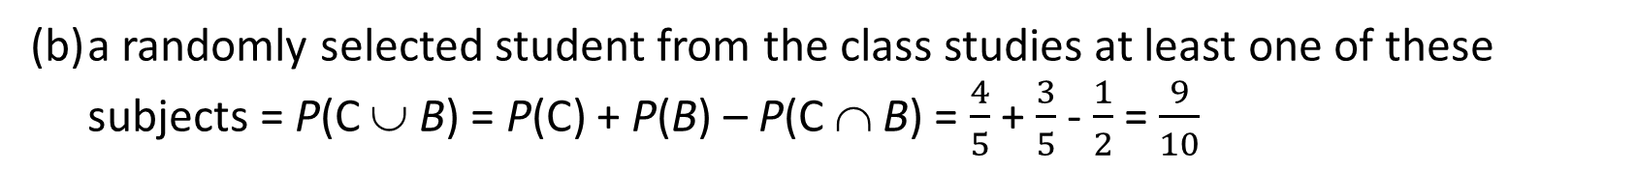
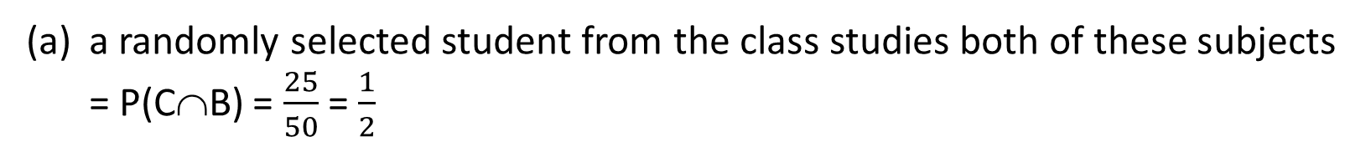
Example 1 – Probabilities
In a class of 50 students, 40 students study Chemistry and 30 students study Biology, and 25 students study both of these subjects. Find the probability that a randomly selected student from the class studies: (a) both of these subjects; (b) at least one of these subjects; (c) studies neither of these subjects.
Let C be the event that a randomly selected student studies Chemistry.
Let B be the event that a randomly selected student studies Biology.
$P(C)=\frac{40}{50}$ = $\frac{4}{5}$
$P(B)=\frac{30}{50}$ = $\frac{3}{5}$
a randomly selected student from the class studies both of these subjects = P(C∩B) = $\frac{25}{50}$ = $\frac{1}{2}$
(b) a randomly selected student from the class studies at least one of these subjects = P(C ∪ B) = P(C) + P(B) – P(C ∩ B) = $\frac{4}{5}$ + $\frac{3}{5}$ - $\frac{1}{2}$ = $\frac{9}{10}$
(c) a randomly selected student from the class studies neither of these subjects = P((C∪B)^{c}) = 1- P(C∪B) = 1- $\frac{9}{10}$ = $\frac{1}{10}$

Slide 11
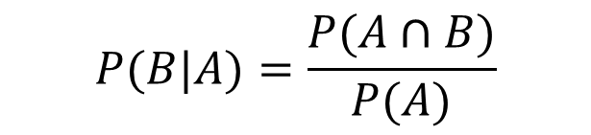
Conditional Probability
The probability of an event B occurring, given that an event A has occurred, is written as P(B|A). It is fair to assume here that since A has occurred, that P(A) ≠ 0.
Definition: Conditional Probability
Let A and B be events in a sample space S. If P(A) ≠ 0, then the conditional probability of B given A, denoted P(B|A), is
$$P(B|A)=\frac{P(A∩B)}{P(A)}$$
9.1

Slide 12
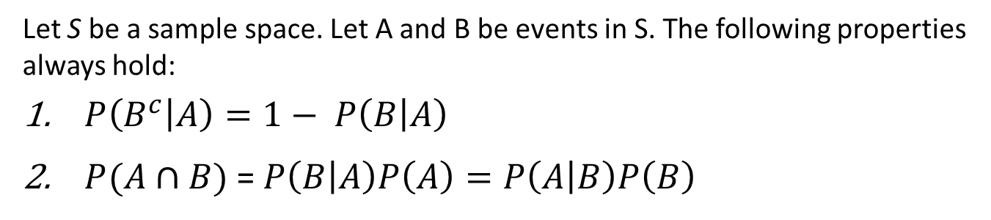
Conditional Probability - Properties
Basic Properties of Conditional Probability
Let S be a sample space. Let A and B be events in S. The following properties always hold:
$P\left(B^{c} | A\right)=1− P\left(B | A\right)$
$P(A∩B)$= $P\left(B | A\right)P\left(A\right)=P\left(A | B\right)P\left(B\right)$

Slide 13

Conditional Probability
Example 2 – Applying Conditional Probabilities
An urn contains 5 blue and 7 gray balls. Let us say that 2 are chosen at random, one after the other, without replacement.
Find the following probabilities: the probability that both balls are blue, the probability that the first ball is not blue and the second ball is blue.
What is the probability that the second ball is blue?
Let
S denote the sample space of all possible choices of two balls from the urn,
B₁ be the event that the first ball is blue (then B₁^{c} is the event that the first ball is not blue),
B₂ be the event that the second ball is blue (then B₂^{c} is the event that the second ball is not blue).

Slide 14
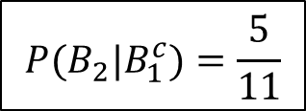
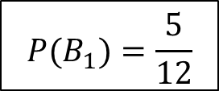
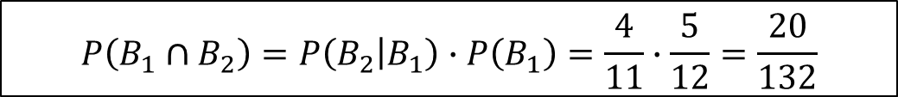
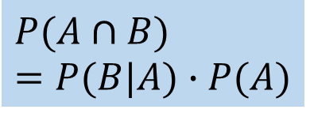
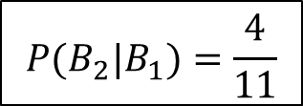
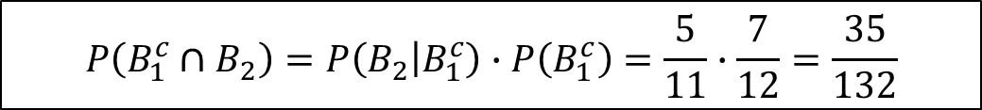
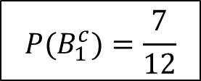
Conditional Probability
Example 2 – Applying Conditional Probabilities
5 blue, 7 gray.
a. Find: prob both balls are blue, P(B₁ ∩ B₂); 1st ball not blue and 2nd ball blue, P(B₁^{c} ∩ B₂)
$$P(B_{1})=\frac{5}{12}$$
$$P(B_{1}^{c})=\frac{7}{12}$$
$$P({B_{2}|B}_{1})=\frac{4}{11}$$
$$P(B_{2}|B_{1}^{c})=\frac{5}{11}$$
$$P\left(B_{1}∩B_{2}\right)=P\left(B_{2} | B_{1}\right)∙P\left(B_{1}\right)=\frac{4}{11}∙\frac{5}{12}=\frac{20}{132}$$
Note: formula 9.1
$$P\left({B_{1}^{c}∩B}_{2}\right)=P\left(B_{2} | B_{1}^{c}\right)∙P\left(B_{1}^{c}\right)=\frac{5}{11}∙\frac{7}{12}=\frac{35}{132}$$
$$P(A∩B)=P(B|A)∙P(A)$$

Slide 15


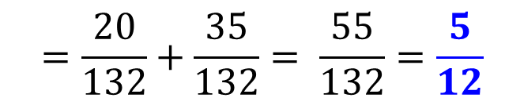
Conditional Probability
Example 2 – Applying Conditional Probabilities
5 blue, 7 gray.
What is the probability that the 2nd ball is blue?
First ball is blue and second is also blue, OR
first ball is gray and second is blue.
They are mutually exclusive.
$$P\left(B_{2}\right)=P(\left(B_{2}∩B_{1}\right)∪\left(B_{2}∩B_{1}^{c}\right))$$
$$=P\left(B_{2}∩B_{1}\right)+P\left(B_{2}∩B_{1}^{c}\right)$$
$$=\frac{20}{132}+\frac{35}{132}= \frac{55}{132}=\frac{5}{12}$$

Slide 16
Bayes’ Theorem
Theorem 10.8.1 Bayes’ Theorem
Suppose that a sample space S is a union of mutually disjoint events B₁, B₂, B₃, …, B_{n}.
Suppose A is an event in S, and suppose A and all the B_{i} have non-zero probabilities.
If k is an integer with 1 ≤ k ≤ n, then
$$P\left(B_{k} | A\right)= \frac{P(A|B_{k})∙P(B_{k})}{P\left(A | B_{1}\right)∙P\left(B_{1}\right)+P\left(A | B_{2}\right)∙P\left(B_{2}\right)+⋯+P(A|B_{n})∙P(B_{n})}$$

Slide 17
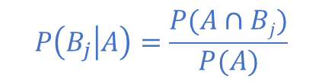
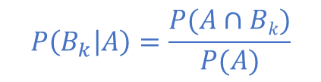
Rationale behind Bayes’ Theorem
$$P\left(B_{k} | A\right)=\frac{P(A∩Bk)}{P(A)}$$
---------------------------------(1)
A$=\left(A∩ B1\right)∪\left(A∩ B2\right)$ $∪$……………….. $∪\left(A∩ Bn\right)$
Hence,
P(A)$=P\left(A∩B1\right)+P\left(A∩ B2\right)+$………………..$+ P\left(A∩ Bn\right)$
$$P\left(B_{j} | A\right)=\frac{P(A∩Bj)}{P(A)}$$
implies P(A∩B_{j}) = P(A⎢B_{j}) ⋅ P(B_{j}), 1 ≤ j ≤ n
$$P\left(A\right)= P\left(A | B_{1}\right)∙P\left(B_{1}\right)+P\left(A | B_{2}\right)∙P\left(B_{2}\right)+⋯+P(A|B_{n})∙P\left(B_{2}\right)$$
----------------------(2)
Sub (2) in (1) we get,
$$P\left(B_{k} | A\right)= \frac{P(A|B_{k})∙P(B_{k})}{P\left(A | B_{1}\right)∙P\left(B_{1}\right)+P\left(A | B_{2}\right)∙P\left(B_{2}\right)+⋯+P(A|B_{n})∙P(B_{n})}$$

Slide 18
Bayes’ Theorem
Example 3 – Applying Bayes’ Theorem
Most medical tests occasionally produce incorrect results, called false positives and false negatives.
When a test is designed to determine whether a patient has a certain disease:
A true positive result indicates that a patient has the disease when the patient has it.
A false positive result indicates that a patient has the disease when the patient does not have it.
A true negative result indicates that a patient does not have the disease when the patient does not have it.
A false negative result indicates that a patient does not have the disease when the patient does have it.

Slide 19
Bayes’ Theorem
Example 3 – Applying Bayes’ Theorem
Consider a medical test that screens for a disease found in 5 people in 1,000. Suppose that the false positive rate is 3% and the false negative rate is 1%.
That is, 3% of the time a person who does not has the condition tests positive for it, and 1% of the time a person who has the condition tests negative for it.
What is the probability that a randomly chosen person who tests positive for the disease actually has the disease?
What is the probability that a randomly chosen person who tests negative for the disease does not indeed have the disease?

Slide 20






Bayes’ Theorem
Example 3 – Applying Bayes’ Theorem
Consider a person chosen at random from among those screened. Let
A be the event that the person tests positive for the disease,
B₁ the event that the person actually has the disease, and
B₂ the event that the person does not have the disease.
Then, P(A|B₁) = 1 – P(A^{C}|B₁) and P(A^{C}|B₂) = 1 – P(A|B₂)
Hence,
$$P\left(A^{c} | B_{1}\right)=0.01$$
$$P\left(A | B_{2}\right)=0.03$$
$$P\left(A | B_{1}\right)=0.99$$
$$P\left(A^{c} | B_{2}\right)=0.97$$
Also, because 5 people in 1000 have the disease,
$$P(B_{1})=0.005$$
$$P(B_{2})=0.995$$

Slide 21
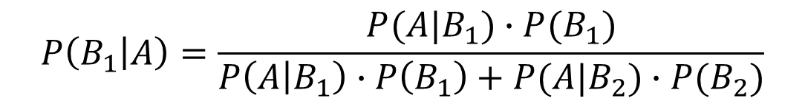

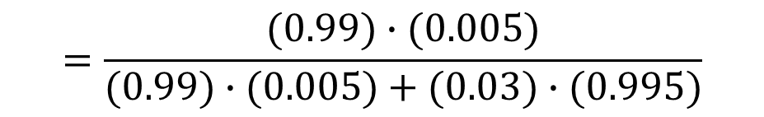
Bayes’ Theorem
Example 3 – Applying Bayes’ Theorem
What is the probability that a randomly chosen person who tests positive for the disease actually has the disease?
By Bayes’ Theorem,
$$P\left(B_{1} | A\right)=\frac{P(A|B_{1})∙P(B_{1})}{P\left(A | B_{1}\right)∙P\left(B_{1}\right)+P(A|B_{2})∙P(B_{2})}$$
$$=\frac{(0.99)∙(0.005)}{(0.99)∙(0.005)+(0.03)∙(0.995)}$$
$$≅0.1422 ≅14.2\%$$
Thus the probability that a person with a positive test result actually has the disease is approximately 14.2%.

Slide 22
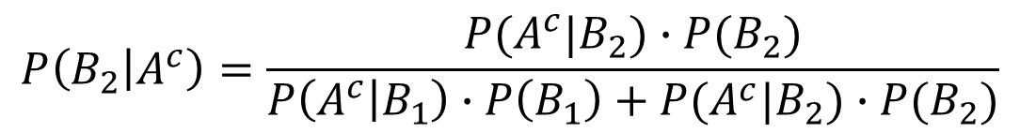

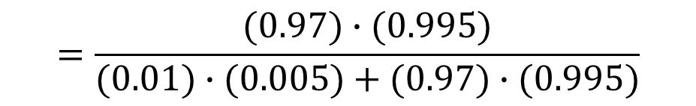
Bayes’ Theorem
Example 3 – Applying Bayes’ Theorem
What is the probability that a randomly chosen person who tests negative for the disease does not indeed have the disease?
By Bayes’ Theorem,
$$P\left(B_{2} | A^{c}\right)=\frac{P(A^{c}|B_{2})∙P(B_{2})}{P\left(A^{c} | B_{1}\right)∙P\left(B_{1}\right)+P(A^{c}|B_{2})∙P(B_{2})}$$
$$=\frac{(0.97)∙(0.995)}{(0.01)∙(0.005)+(0.97)∙(0.995)}$$
$$≅0.999948 ≅99.995\%$$
Thus the probability that a person with a negative test result does not have the disease is approximately 99.995%.

Slide 23
Independent Events
For convenience and to eliminate the requirement that the probabilities be nonzero, we use the following product formula to define independent events.
Originally, two events A and B are independent if and only if P(A⏐B) = P(A) and P(B ⏐A) = P(B)
Definition: Independent Events
If A and B are events in a sample space S, then A and B are independent, if and only if,
P(A ∩ B) = P(A) ⋅ P(B)

Slide 24
Independent Events
Example 4 – Computing Probabilities of Intersections of Two Independent Events
A coin is loaded so that the probability of heads is 0.6. Suppose the coin is tossed twice. Although the probability of heads is greater than the probability of tails, there is no reason to believe that whether the coin lands heads or tails on one toss will affect whether it lands heads or tails on the other toss. Thus it is reasonable to assume that the results of the tosses are independent.
What is the probability of obtaining two heads?
What is the probability of obtaining one head?
What is the probability of obtaining no heads?
What is the probability of obtaining at least one head?

Slide 25
Independent Events
Example 4 – Computing Probabilities of Intersections of Two Independent Events
Sample space S consists of the 4 outcomes {HH, HT, TH, TT} which are not equally likely.
Let
E be the event that a head is obtained on the first toss
F be the event that a head is obtained on the second toss
P(E) = P(F) = 0.6.

Slide 26
Independent Events
Example 4 – Computing Probabilities of Intersections of Two Independent Events
What is the probability of obtaining two heads?
P(two heads) = P(E ∩ F) = P(E) ⋅ P(F) = (0.6)(0.6) = 0.36 = 36%
What is the probability of obtaining one head?
P(one head) = P((E ∩ F^{c}) ∪ (E^{c} ∩ F)) = P(E) ⋅ P(F^{c}) + P(E^{c}) ⋅ P(F)
= (0.6)(0.4) + (0.4)(0.6) = 0.48 = 48%
What is the probability of obtaining no heads?
P(no heads) =
P(E^{c} ∩ F^{c}) = P(E^{c}) ⋅ P(F^{c}) = (0.4)(0.4) = 0.16 = 16%

Slide 27
Independent Events
Example 4 – Computing Probabilities of Intersections of Two Independent Events
What is the probability of obtaining at least one head?
Method 1:
P(at least one head) = P(one head) + P(two heads) = 0.48 + 0.36
= 0.84 = 84%
Method 2:
P(at least one head) = 1 – P(no heads) = 1 – 0.16 = 0.84 = 84%

Slide 28
End of Unit 9

